Slide 1
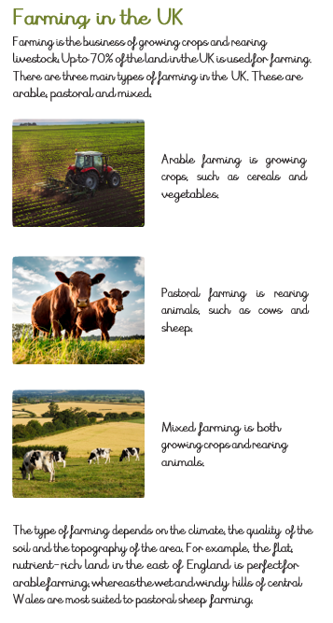
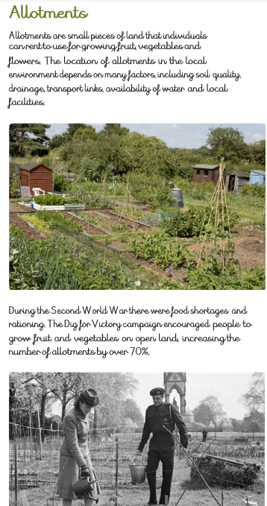
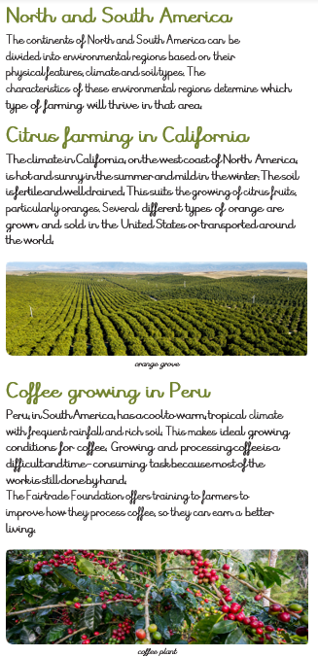
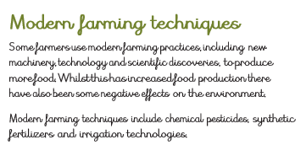
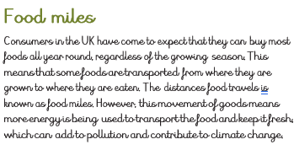
Year 3/4 Fairtrade and food miles
Subject Specific Vocabulary
Renewable fuels | Renewable fuels are fuels produced from renewable resources
Non-renewable fuels | Non-renewable energy comes from sources that will run out or will not be replenished in our lifetimes
Export | Send goods to another country.
Import | Bring goods into a country.
Developed Countries | A country which has a developed economy and advanced technological infrastructure.
Minerals | A mineral is, a solid chemical compound that occurs naturally in pure form
Distribution | The way in which something is shared out.
Fairtrade | This means fairer pay and more power in the hands of farmers, so that they can build a fairer future for their communities
Food miles | the distance between where something is grown to where it’s eaten
Natural resources | are materials or substances that are produced by the environment.
The UK has a lot of natural resources, including fossil fuels for energy, crops for food, and livestock for food as well as clothes

