Slide 1



Newsletter
Date: 27/2/26
Becoming the person God made me to be: living, learning, loving.
“I praise you because I am fearfully and wonderfully made” Psalm 139:14

Slide 2
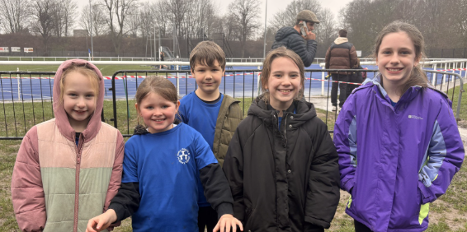
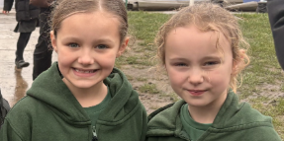
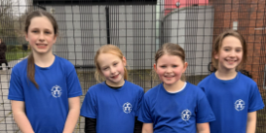
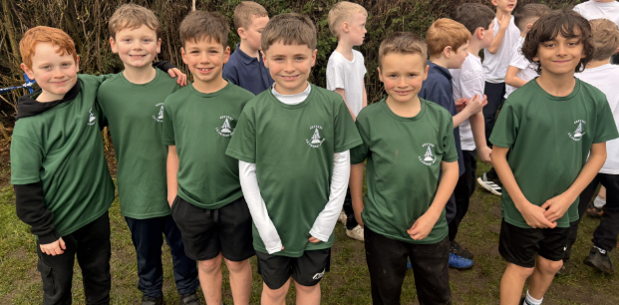
Y3/4 Cross Country – Tuesday 10th February
On Tuesday 10th February, our KS2 Cross Country team went to Pingles for the final race of the season.
In the girls' race, Lilly finished in 10th position, followed by Adelaide in 11th, Georgia in 13th, Sybill in 21st, Sienna in 34th and Lissy in 37th.
In the boys' race, Alfie came in 6th position, Felix in 16th, Eddie in 18th, Tommy in 27th, Hugh in 33rd, Joey in 45th and Jacob made his XC debut finishing in 49th place. The conditions under-foot were very slippy after all the rain but the team did brilliantly to stay on their feet!
Well done to Lilly, Adelaide, Georgia, Alfie, Eddie and Hugh who have been selected to run for North Warwickshire in the team event after half term.

Slide 3
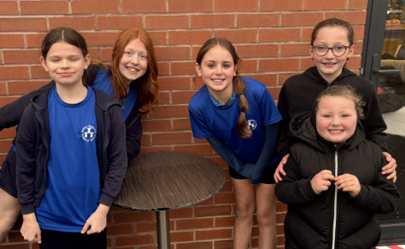
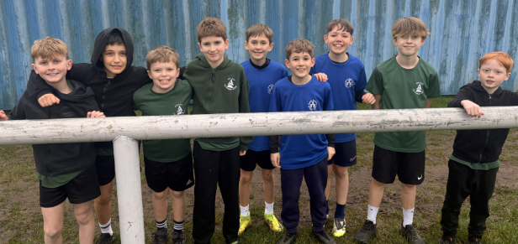
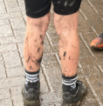
Y5/6 Cross Country – Tuesday 10th February
In the Y5/6 girls' race, Nessa came away with the bronze medal for the second race in a row. Amber finished 13th, her highest finish position of the season, Arabella came in next in 15th and Leah in 29th.
We had a talented team out in the boys' race – with Freddie finishing in 3rd place to take away his second medal of the season. Arlo just missed out on a medal, coming in in 4th place, Lincoln shortly after in 7th, followed by Jacob (12th), Dougie (17th), Rory (25th), Ollie (31st), Joseph (33rd) and Rafe (36th). The boys' team also won the award for being the filthiest group of the day – there wasn't a clean leg in sight!
Nessa, Arlo, Rory, Arabella, Amber, Darcie, Freddie, Jacob and Lincoln have also been selected to race for North Warwickshire on Wednesday 25th February against the runners from Nuneaton and Bedworth schools. Good luck!

Slide 4
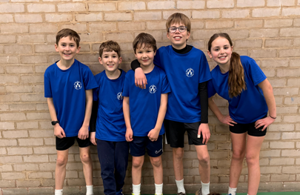
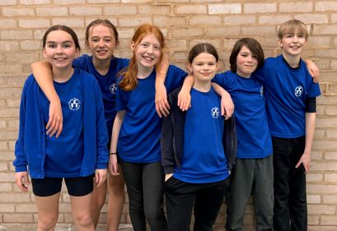
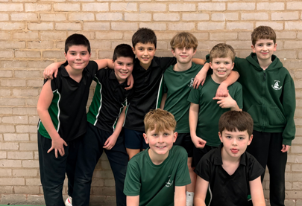
Y5/6 Dodgeball Competition
On Friday 13th February, three teams took part in a dodgeball competition at Kingsbury Community Centre against Dordon, Shustoke and Water Orton schools.
Six teams took part in the tournament with each team playing 5 games. The competition was incredibly close, with the final point difference being 1.5 between 1st place and 4th place. Team 2 from Newton were also highly praised for their fantastic team-work, smiley faces and honesty throughout all of their games which was lovely to hear.
Austrey finished in 2nd place, and Newton Team 1 in 3rd, meaning these two teams progress to the final on 6th March.

Slide 5
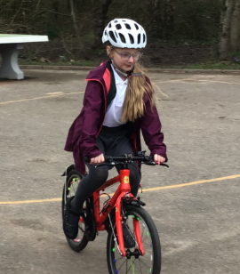
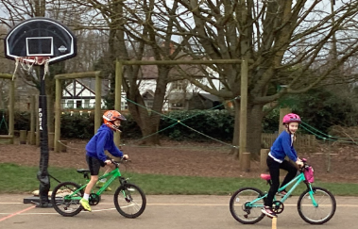
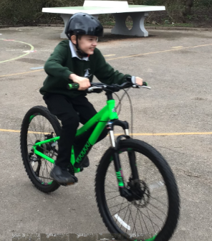
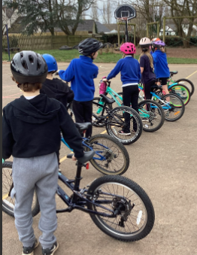
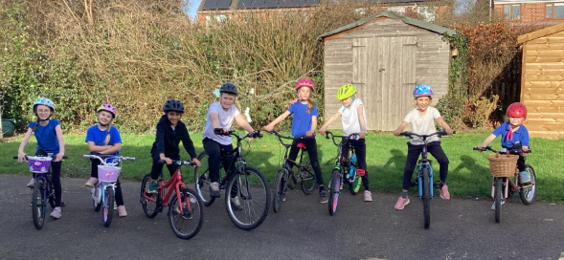
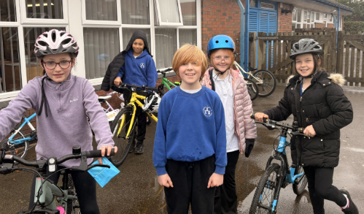
Bikeability – Y3/4/5
This week, children in Y3, 4 and 5 have been taking part in Level 1 and Level 2 Bikeability courses. Y3 and Y4 were playground-based whereas Y5 were learning about being safe whilst riding on the village roads. All children thoroughly enjoyed themselves and enjoyed the fresh air and nice weather!

Slide 6

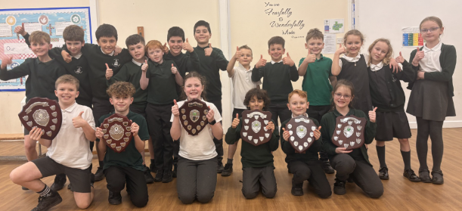
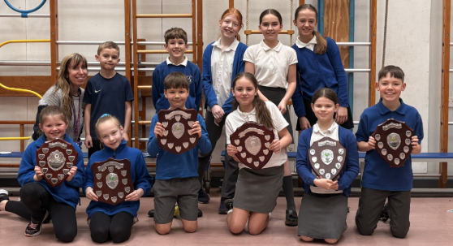
Cross Country CHAMPIONS 2025-2026
This week we received the final scores from the XC season and it was wonderful to discover that Austrey & Newton topped the tables in all competitions:
Year 3 and 4 Boys Year 5 and 6 Boys Year 3 and 4 Overall
Year 3 and 4 Girls Year 5 and 6 Girls Year 5 and 6 Overall

Slide 7
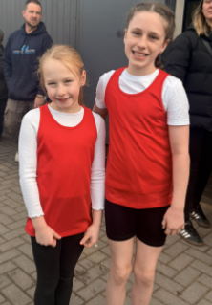
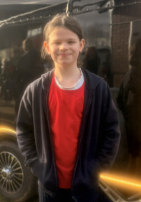
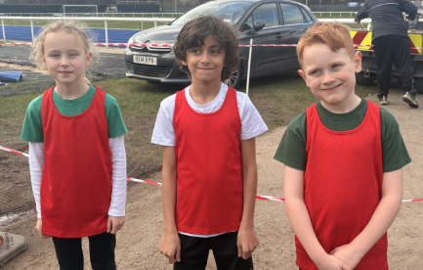

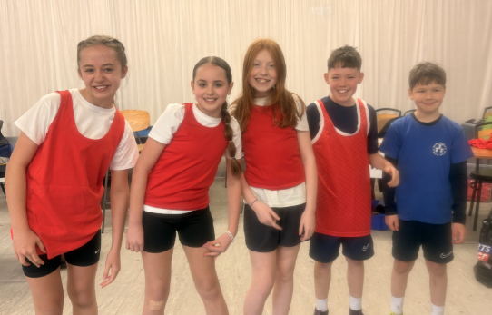
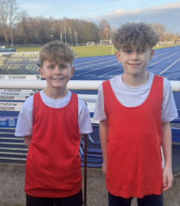
Inter-District Cross Country –
Wednesday 26th February

Slide 8
Inter District XC Results
On Wednesday 25th February, on what was the warmest February day in 7 years (apparently!), 14 children from KS2 represented North Warwickshire at Pingles in the Inter-District XC races against Bedworth and Nuneaton teams. For this event, children ran in single year group races for the first time. In the Y3 girls' race – Adelaide finished in 6th position and Lilly finished in 8th, meaning both girls were chosen to race in the Warwickshire finals.. In the Y4 girls' race, Georgia placed 9th meaning she also advanced to the next stage. In the Y3 boys' race, Alfie finished just outside of the top ten, in 11th position, putting him down as first reserve for his age group. Hugh finished in 24th and Eddie 32nd in the Y4 boys' race. In the Y5 races, Nessa finished in 4th position and was therefore selected for the next round. Rory finished in 17th in the Y5 boys race, along with Lincoln (18th), Jacob (21st) and Freddie (26th) in the Y6 boys race. For the Y6 girls, Arabella came 18th, Darcie 21st and Amber 26th. All children tried their best on what was a much longer course than what they had been used to racing. The Y3/4 race measured 1.6km and the Y5/6 race measured 2.4km.
Well done to those who will race again on Saturday 7th March, representing the county.

Slide 9



This will be taking place at lunchtime so please send your child in with the £4 in an envelope on one of the days and they will be able to visit the shop and choose a present.
Details of the FPTA Mother’s Day wrap at Newton to follow for 9th March

Slide 10
Date: 13.2.26
Wagtails | Vivienne - Justice
Ducklings: | Albie - Community
Harlequin: | Jax - Community
Robins: | Bellerose - Forgiveness
King Eider: | Coby - Forgiveness
Owls: | Mila - Justice
Mandarin: | Arlo - Community
Kingfishers | Ronnie - Trust
Date:27.2.26
Wagtails: | Shea – Community
Ducklings | George - Hope
Harlequin: | Ivy - Community
Robins: | Pheonix – Trust
King Eider: | Hazel - Trust
Owls: | Kyan – Forgiveness
Mandarin: | Nessa - Justice
Kingfishers | Rory – Trust
Values Lanyards

Slide 11
Pupils of the week
Date: | 13.2.26
Wagtails | Olivia J
Ducklings | Charlie B
Harlequin | Freddie T
Robins | Oscar
King Eider | Alfie W
Owls | Mila
Mandarin | Darcie G
Kingfishers | Rafe
Date: | 27.2.26
Wagtails | Neveah
Ducklings | Olivia W
Harlequin | Taaliah
Robins | Billy
King Eider | Bella B
Owls | Jacey-Leigh
Mandarin | Daisy F
Kingfishers | Joseph

Slide 12
Information from Warwickshire Attendance service
LEAVE OF ABSENCE DURING TERM TIME UPDATED INFORMATION FOR PARENTS
The Supreme Court has clarified the law on unauthorised leave, including holidays, during term time (Platt v Isle of Wright 2017). The Supreme Court has made clear that attending school ‘regularly’ means that the children must attend school on every day that they are required to do so. As such, the parents of any child who is absent from school without authorisation for any length of time are likely to be considered as committing an offence under s444 of the Education Act 1996.
The law states a leave of absence may only be granted by a school if an application is made in advance and if it considers there are exceptional circumstances relating to the application.
Schools must judge each application individually considering the specific facts and circumstances and relevant background context behind each request.
A leave of absence is granted entirely at the school’s discretion. Generally, a need or desire for a holiday or other absence for the purpose of leisure and recreation would not constitute an exceptional circumstance.
Where a leave of absence is granted, the school will determine the number of days a pupil can be absent from school.

Slide 13
When making an application for Leave of Absence parents are advised to give sufficient information and time to allow the Head teacher the opportunity to consider all the exceptional circumstances and to notify parents of their decision. The school may also request further information on the application and supporting documentation where appropriate.
It is advised that if the resident parent has not received notification or a response regarding the leave of absence application, it is the parents’ responsibility to ascertain if the leave is authorised prior to the start of the leave.
The school can only consider Leave of Absence requests which are made by the ‘resident’ parent ie the parent with whom the child normally resides.
Where applications for leave of absence are made in advance and refused, the child is expected to be in school on the dates set out in the application. If the child is absent during that period, it will be recorded as an unauthorised absence. Where a leave of absence is requested, but additional days taken either prior to or after the request may be considered as part of the leave of absence.
Leave of Absences which are not made in advance cannot be authorised in line with legislation. This will result in the absence being recorded as ‘unauthorised’.
All matters of unauthorised absence relating to a Leave of Absence will be referred to the Warwickshire Attendance Service, part of Warwickshire County Council. Penalty Notices are issued in accordance with Warwickshire County Council’s Code of Conduct for Penalty Notices and in the first instance, as an alternative to prosecution proceedings.

Slide 14
The law relating to Penalty Notices changed with effect from 19 August 2024. Therefore, Penalty Notices issued for Leave of Absence taken from September 2024 will be issued in accordance with the updated legislation.
Penalty Notices are issued to each parent of each absent child, (for example 2 children and 2 parents, means each parent will receive 2 invoices – 4 in total).
First Leave of Absence offence: The Penalty Notice amount of £160 to be paid within 28 days, this is reduced to £80 each child if paid within 21 days.
Second Leave of Absence offence within a 3 year period (from the date of issue of the first penalty notice): The amount of £160 paid within 28 days. No reduced amount.
Payment plans will not be offered and/or payments received outside of the 28 day period will not be accepted. Where a penalty notice expires unpaid the matter will be referred to Warwickshire County Council’s Legal Services to consider criminal prosecution.
Third Leave of Absence offence within a 3 year period (from the date of issue of the first penalty notice): A penalty notices will be not be issued and the matter will be referred to Warwickshire County Council’s Legal Services to consider instigating criminal prosecution proceedings under S444 of Education Act 1996.
Your child’s progress academically as well as socially is our shared priority.

Slide 15

You can view your child’s attendance certificate ‘live’ through Arbor. If you need help logging into this, please do not hesitate to contact Mrs Pick or Mrs Harvey.
OUR CURRENT ATTENDANCE PERCENTAGES FOR THE
YEAR SO FAR ARE
Austrey
94.8%
Newton Regis
96.1%
(not including nursery as attendance is non statutory)
National is currently 94.6%

Slide 16
Dates for your diaries
WORLD BOOK DAY – Thursday 5th March – details have been sent via Seesaw
Non-Uniform Day – Newton Regis – Pyjamas – Bring a Chocolate donation – Friday 6th March
Mother's Day Wrap – FPTA Newton Regis – Monday 9th March
FACES Mother's Day Shop – Wed 11th/Thurs 12th March
Wagtails Mother's Day Assembly –9am Friday 13th March
Ducklings (Reception Only) – Mother's Day Assembly – Friday 13th March 2:30pm
Comic Relief – Non-Uniform – Friday 20th March details TBC
Y3/4's Easter Play, 9:15 & 2:15 at Newton Regis – Monday 16th March
Y3/4's Easter Play, 9:15 & 2:15 at Austrey – Wednesday 18th March
Wagtails and Robins Easter Bonnet Parade – Tuesday 24th March – 9am.

Slide 17
Dates for your diaries
Newton Regis Easter Church Service – 9am - Wednesday 25th March
Austrey Easter Church Service – 2:15pm - Wednesday 25th March
FACES Bring and Buy Sale – Thursday 26th March
FPTA Chocolate Tombola after school on the playground at Newton – Thursday 26th March
School closes for pupils – Thursday 26th March
School reopens for pupils – Monday 13th April

Slide 18
